Slide 1

EXPERTFINDER EPR
POSTER NOTES
Draft Text and Pictures
Paola Di Maio,
1st Expertfinder Workshop
Berlin, 15 January 2007

Slide 2

FOAF EPR EXPERTFINDER in 2 MINUTES SHARP:
GIVEN A CONTEXT OF SOCIAL NETWORKS AND COLLABORATIVE TAGGING,
1. FOAF CONCEPT HAS THE POTENTIAL OF VERY USEFUL APPLICATION IN CASE OF EMERGENCIES AS WELL AS IN THE FIELD OF HUMANITARIAN PROGRAMMES
2. FOAF REPRESENTATION MAY NEED TO BE IMPROVED AND OPTIMIZED FURTHER, ESPECIALLY IN USABILITY
3. WE SUGGEST A FOAF PROPERTY 'EXPERT' AND SUBSEQUENT PROPERTIES 'EXPERTTYPE'. ONE OF THESE EXPERT TYPE SHOULD BE OF CLASS EPR. WE CONSIDER ADDING A NEW CLASS EPR. WE OPEN THIS IDEA FOR PUBLIC CONSULTATION AT THE WORKSHOP
4. SUBSEQUENTE L2 AND L3 SUBPROPERTIES (sub-sub-proeperties) ARE CONSIDERED, AND THE VALIDITY OF SUCH A DEEP HIERARCHY OF PROPERTY REPRESENTATION IS OPENED FOR DISCUSSION (HOW MANY SUBPROPERTY LEVELS CAN A PROPERTY HAVE?)
5. WE SUGGEST THE DEVELOPMENT OF AN OPEN SOURCE BIT OF CODE THAT CAN BE PASTED INTO ANY WEBSITE IN THE FORM OF A BUTTON (foaf EPR) THAT WOULD LINK TO A URI AND TO AN ONLINE DYNAMIC INDEX LIKE TECHNORATI, DELICIOUS AND FLICKER TYPE
6. WE SUGGEST THE DEVELOPMENT OF A DYNAMIC ONLINE FOAF INDEX PAGE WHERE EXPERT RESOURCES, IN PARTICULAR EPR EXPERT RESOURCES CAN BE LISTED, LOCATED, SEARCHED AND BROWSED
SUGGESTIONS AND IDEAS WELCOME!

Slide 3
EXPERTFINDER FOR EPR
(EMERGENCY AND POVERTY RELIEF)
During emergencies, as in recent years in the case of the Tsunami and Hurricane Katrina as well as many other disasters, millions of people in different countries get online and would like to help. There are also charities and NGOs working worldwide on ongoing povertyลprograms, however the majority of them are not communicating, thus not sharing knowledge and resources that would help leverage the unlimited potential synergy of social networks. This poster launches FOAF as a simple XML protocol that can be effectively deployed to support people2people networks cooperation during emergencies as well as during ongoing poverty alleviation programmes.

Slide 4
ABOUT THIS PRESENTATION
The concept of an open ontology and consequent people
schemas for emergency response, need to be developed at
many levels, but implementation in principle is costless and
trivial, In the spirit of open source and social networking:
launch it, open it up, and let it happen. This poster needs to
be read in conjunction with related position paper and
associated materials to be developed during subsequent
project phases. In this intial phase, we just explore the
technicalities of extending the schema accordingly, and
seek the interest of the IT and ER community for
consultation and participation.

Slide 5
The context
SOCIAL NETWORKS
SOCIAL SEMANTIC DESKTOPS
ARCHITECTURES OF PARTICIPATION
PEER 2 PEER
COLLABORATIVE TAGGING

Slide 6
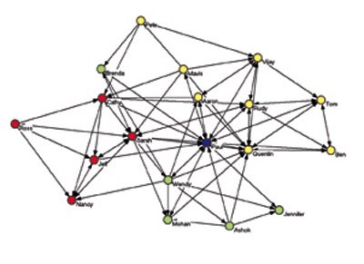
SOCIAL NETWORK

Slide 7
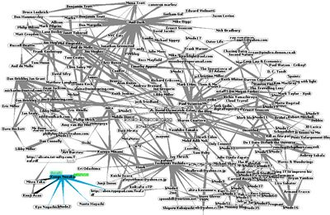
FOAF PEOPLE NETWORK
engo.preston-net.com/archives/2003_12.shtml

Slide 8
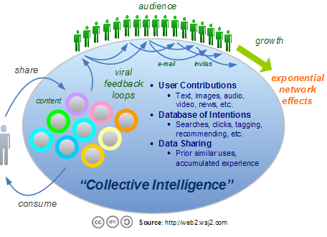
Architecture of Participation

Slide 9
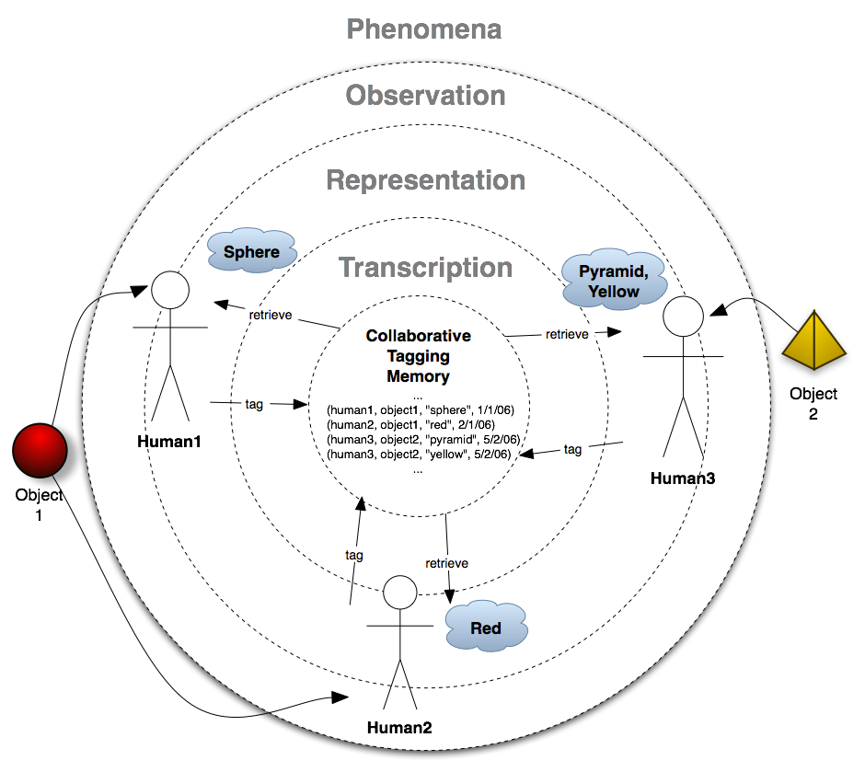
COLLABORATIVE TAGGING
http://myunderstanding.wordpress.com

Slide 10
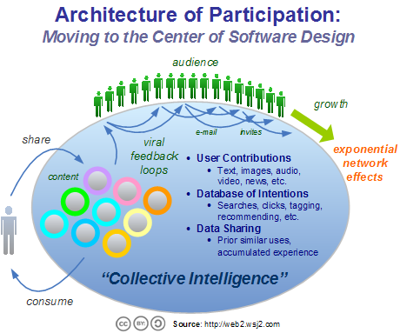

Slide 11
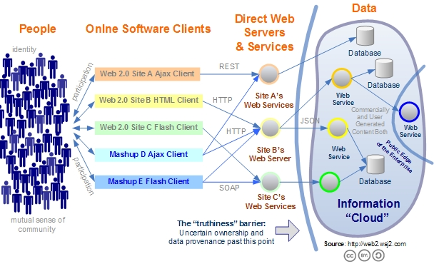
Architecture of Participation

Slide 12
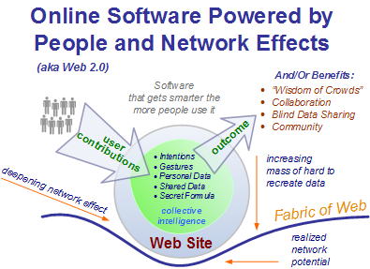

Slide 13
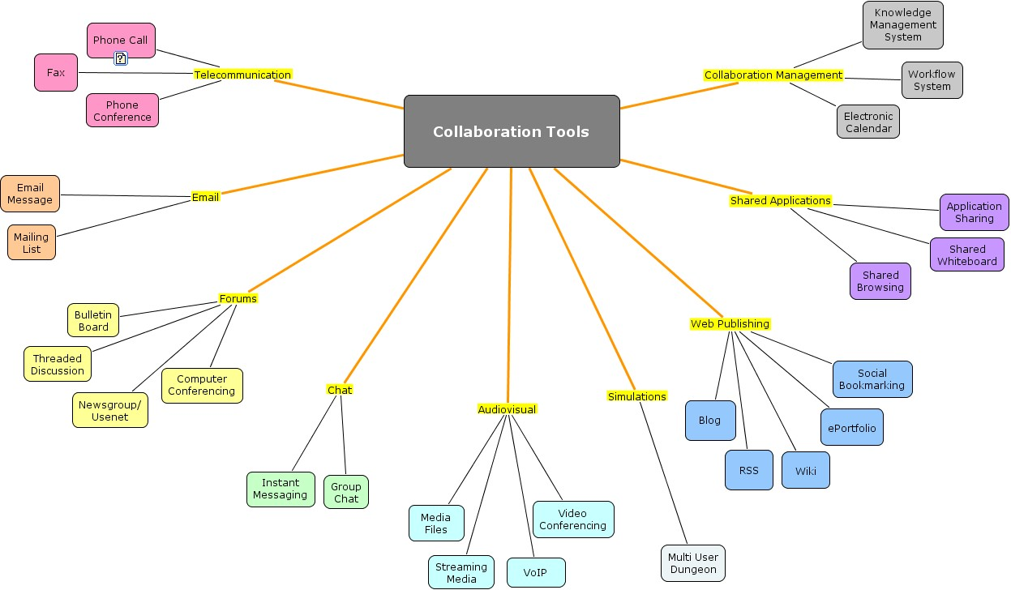

Slide 14
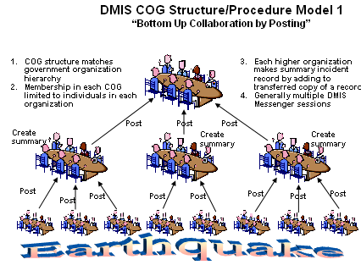
COG MODEL

Slide 15
LIMITATION OF APPROACH
FOAF and EXPERTFINDER ARE BASED ON AN ASSUMPTION OF IMPLICIT TRUST. EXPERTISE IS BASED ON 'SELF CERTIFICATION' (I SAY THAT I AM AN EXPERT IN...)
How to establish trust in highly sensitive context? Should senstitive expertise be 'certifided' by a third party authority?
Suggestion: model and reference existing models of trust

Slide 16
GIVEN
Current FOAF schemas
http://xmlns.com/foaf/0.1/

Slide 17
NEW PROPERTY
Based on the current FOAF spec (SLIDE 14) we assume that a new property called 'expert' is going to be added to current foaf specificatIon following the 1st Expertfinder Workshop, therefore we suggest that two further subproperties are added:
EPRE (where the person is epr expert)
and
EPRRP
(where the person is epr resource provider)

Slide 18
PROJECT TASK: PHASE 1
(To be carried out at the workshop)
EVALUATE CRITICALLY CONCEPTUAL AND SEMANTIC EFFECTIVENESS OF FOAF (why is not widely used?can it be improved?does it have poor usability?)
1- PROPOSE NEW FOAF SUBPROPERTY1 OF foaf:property:expert:eprE (emergency and poverty relief Expert)
2- PROPOSE NEW FOAF SUBPROPERTY2
foaf:property:expert:eprRP (emergency and poverty relief resource provider)

Slide 19
TO IMPROVE FOAF:CONSIDER
- MAKING A CLEAR VISUAL DIAGRAM OF CLASSES, PROPERTIES AND REFERENCE CLEARLY THEIR RELATIONSHIPS (HAS, IS, PROVIDES ETC)
CLEAN UP AND IMPROVE THE RELATIONAL LOGIC PERHAPS
UNDERSTAND WHY FOAF IS NOT BEING ADOPTED (GREAT IDEA, POOR CONCEPTUAL EPRESENTATION/SCHEMA?)

Slide 20
PROJECT TASK: PHASE 2
(To be carried out after workshop)
OPEN CONSULTATION WITH FOAF COMMUNITY TO EVALUATE CRITICALLY THE USEFULNESS OF NEW SUBPROPERTY, SUGGEST IMPROVEMENTS TO REPRESENTATION
CREATE MODULE SPECIFICATION TO SUPPORT AUTOMATIC ROLLOUT OF NEW FOAF EXTENSION (or FOAF IN GENERAL)

Slide 21
PROPOSED
1. CREATE NEW PROPERTY:EXPERT
2 CREATE NEW SUBPROPERTIES EPR
AND LEV2 SUBPROPERTIES EPRE AND EPRRP (not sure how to best represent this)

Slide 22
NEW SUB-PROPERTY 1: EPR
IF
NEW PROPERTY IS BEING ADDED TO FOAF VOCABULARY: EXPERT (ASSUMPTION)
AND RELATIONSHIP 'IS'
THEN
SUBPROPERTY1 IS EPR
CLASS: <PERSON>, <ORGANISATION>
PROPERTY: <EXPERT>
SUBPROPERTY: <EPRE>

Slide 23
SUB-PROPERTY 2
IF
NEW PROPERTY IS BEING ADDED TO FOAF VOCABULARY: EXPERT (ASSUMPTION)
AND EXPERT IS EPRE (foaf:person:expert:epr)
THEN
SUBPROPERTY2IS EPRRP (RESOURCE PROVIDER)
foaf:person:expert:eprRP
CLASS: <PERSON>, <ORGANISATION>
PROPERTY: <EXPERT>
SUBPROPERTY1: <EPRE>
SUBPROPERTY2 <EPR-RP>

Slide 24
FOAF SCHEMA FOR EPR EXPERT: DISCUSS
foaf: Person (class) of Organisation (class)
foaf: expert (property)
foaf: eprE (subproperty1)
foaf: eprRP (subproperty2)
person:expert:epr:medical:pediatrician

Slide 25
EPR subproperties and URIs Notes/TO DO
1. consider and reference existing public resources and open ontologies
[see: Ontoweb and http://www.daml.org/ontologies/179]
- Define A structured list (hierarchy) of expertise categories including all types of expertise that can be called upon during emergencies (medical, first aid, other) and that can be leveraged as part of ongoing povery alleviate (dentist?malaria?)
Define Categories of RESOURCES that can be required/useful during emergencies and poverty alleviation programs
LINK EPR PROPERTIES TO URIs WHERE AVAILABLE

Slide 26
IMPORTANT
EPR must be linked to other properties
CONTACT
GEOLOCATION
ACCESS TO COMMUNICATION AND TRANSPORT

Slide 27
QUESTIONS 1 FOR THE WORKSHOP:
HOW TO REPRESENT THE SUBPROPERTIES OF EPR?
how many hierarchical branches should we have: for example, is this too deep:
foaf:person:
expert:
epr:
medical
:specialistoptician

Slide 28
QUESTION 2 FOR THE WORKSHOP
how to related eprE and eprRP subproperties? For example,
EPRE can also be/must be/ EPRRP
or
EPRRP must be EPRE, or not necessarily?
or such cardinality does not matter

Slide 29
NEXT:
1) CREATE OPEN SOURCE CODE FUNCTION TO SUPPORT FOAF METADATA ON BLOGS = THAT CAN WORK ON ALL PLATFORMS
SAME AS RSS/XML BUTTON, MAKE A FOAF BUTTON TO VIEW FOAF NETWORK THAT CAN BE PASTED ONTO SITES

Slide 30
NEXT: AGGREGATION
CREATE AGGREGATED INDEX ONLINE OF ALL THE FOAF:EXPERT: EPR
TAGS (IE: TREAT FOAF EPR PROPERTY AS METADATA AND USE, DISPLAY AND SPREAD VIRALLY ACCORDINGLY)
Like technocrati, de.li.cious, flickr and the like, especially for FOAF people and more especially for FOAF EPR during emergency

Slide 31
... MORE....MORE...
THESE OUR JUST OUR IDEAS FOR BRAINSTORM
DISCUSS AND DECIDE ACCORDINGLY
PRODUCE ROADMAP AND ROLLOUT PLAN?

Slide 32
Sources and References
http://xmlns.com/foaf/0.1/
http://kengo.preston-net.com/archives/2003_12.shtml
web-services.gov/brief-userSmartsOverview-031020.ppt
http://www.daml.org/ontologies/179]
colab.cim3.net/file/work/SICoP/2005-10-20/SemanticInteroperabilityatWork.ppt
www.cmi-services.org/includes/PhoenixTraining/02_COGCookbookCourse/02_05_22COGCookbookLesson5_files/frame.htm

